Slide 1
Zomato: A Case Study for Understanding Crowdsourcing in Restaurant Review Systems
Riya Dutta Jasleen Sekhon
Project Advisor:
Dr. Partha Basuchowdhuri

Slide 2
What is the case study about?
We aim to understand the crux of Zomato -
Whether what they say is what they do?
Whether location of a restaurant plays a role in the popularity of an eatery?
Do the reviews tell a story that is not transparent enough for the common users?
Can we find crucial information from such a crowdsourcing platform?
Does it give us any insight into user behaviour?
All these questions have been glanced at and worked upon and we present our findings herewith.

Slide 3
Problem Definition
To understanding the interdependency of a restaurant’s popularity and the cuisines they offer.
To understand how the categorisation of locations would have been by taking the proximity of a restaurant to others into account.
We aim to classify users and gain insight to the user’s activity by checking the contexts of the reviews written.
To find a reasonable accurate mixture of topics within the set of reviews of a user - context detection.

Slide 4
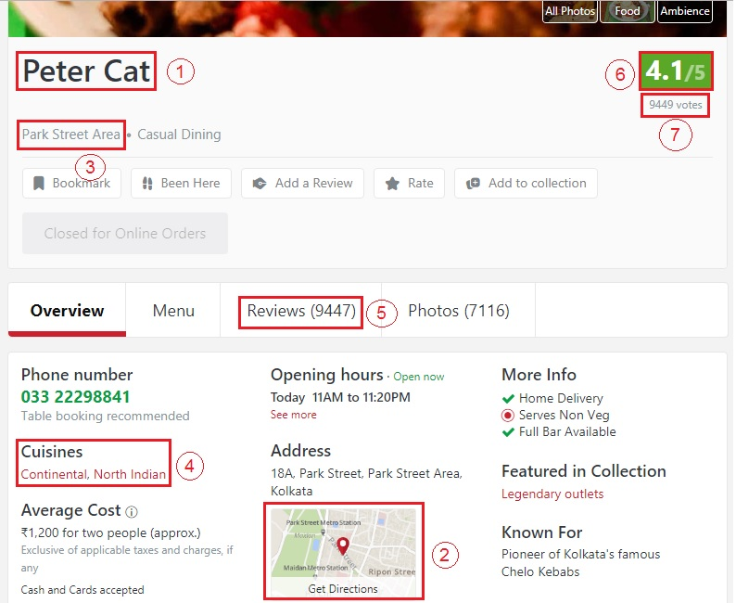
Restaurant Data
Attributes:-
Restaurant name (1)
Link
Entity id
Latitude and Longitude (2)
Area tags (3)
Cuisines (4)
Review count (5)
Restaurant rating (6)
Number of votes (7)

Slide 5
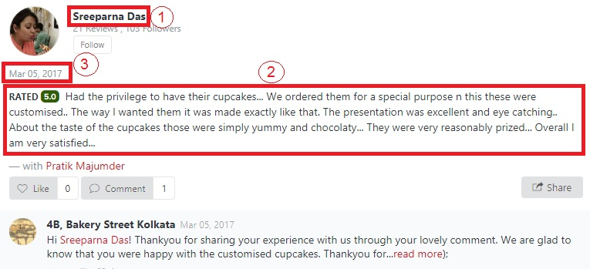
Review Data
Attributes:-
User id
Username (1)
Rating (2)
Review text (2)
Date and time (3)

Slide 6
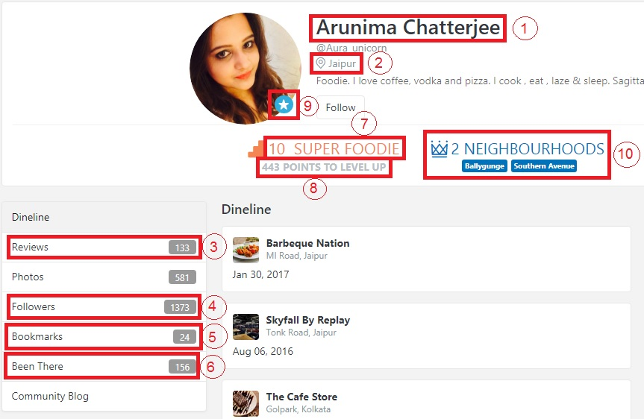
User Data
Attributes:-
Name (1)
Location (2)
No. of reviews (3)
No. of followers (4)
Count of bookmarks (5)
Count of been there (6)
Foodie level (7)
Points to level up (8)
Verified or unverified user (9)
No. of neighbourhoods the user is expert at (with their names) (10)

Slide 7
Cuisines on Zomato

Slide 8
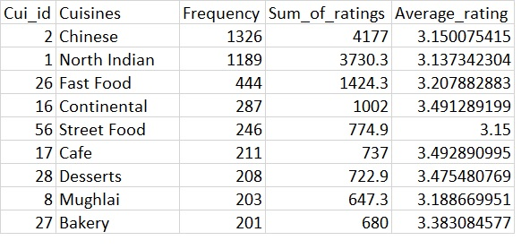
Enumeration of the set of cuisines over all the restaurants in Kolkata
Calculation of the frequency of each cuisine in the data set and the average rating obtained by restaurants of a particular cuisine
There are a total of 75 unique cuisines in Kolkata and the average rating mostly ranges between 3 - 3.5.
Snapshot of data: Cuisines, frequency of occurrence and average ratings

Slide 9
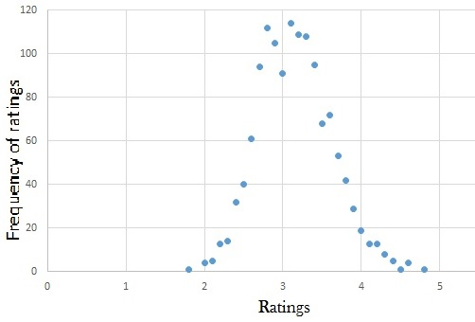
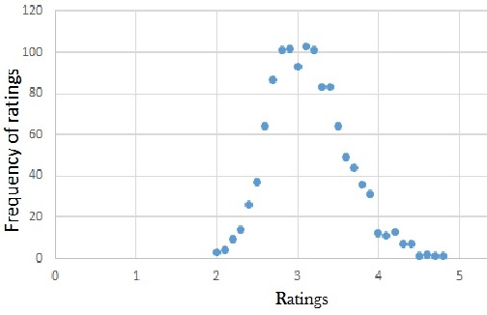
Rating distribution of restaurants with Chinese cuisine
Rating distribution of restaurants with North Indian cuisine

Slide 10
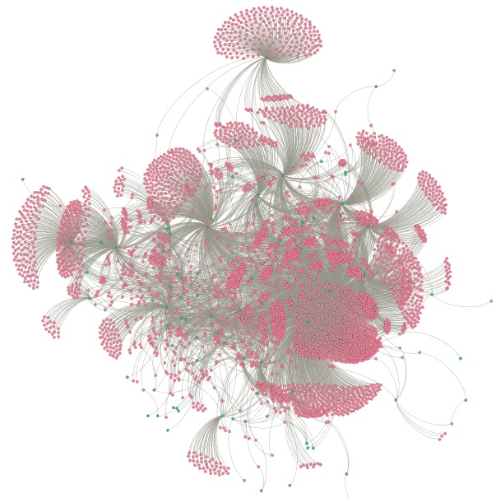
Bipartite graph of restaurants and cuisines
Visualisation of cuisines and restaurants
Cuisines in Green
Restaurants in Pink

Slide 11
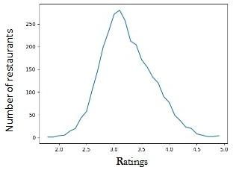
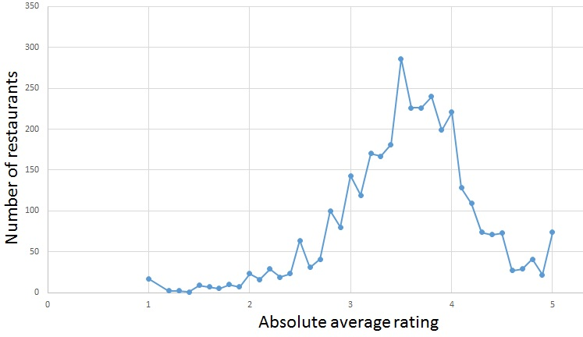
Restaurant Ratings
Normal curve of ratings of all restaurants in Kolkata
Absolute average rating distribution of all restaurants in Kolkata

Slide 12
Areas on Zomato
Two types of area tags:-
9 Major zones: South Kolkata, North Kolkata, Central Kolkata, Salt Lake area, Howrah, etc.
106 Minor zones: Ballygunge, Lake town, Desapriya Park, Camac street, etc.
For visualisation of restaurants using latitude and longitude
Plot of major zones of Kolkata
Plot of minor zones present in each major zone

Slide 13
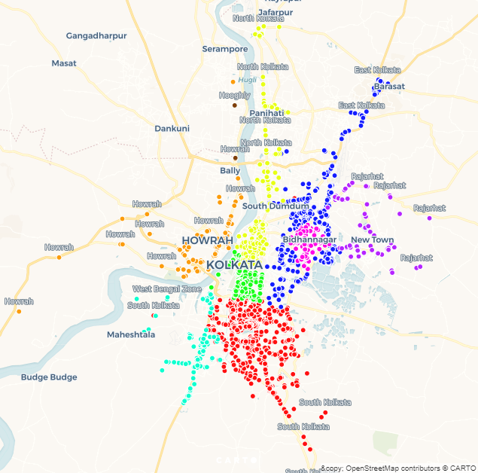
Major zones in Kolkata

Slide 14
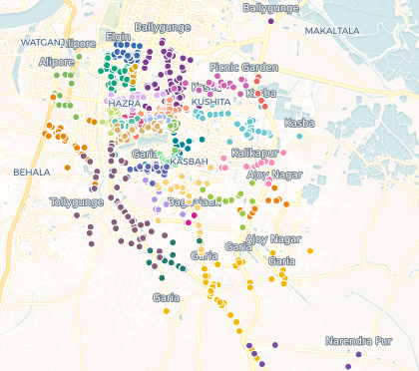
Minor zones in Kolkata

Slide 15
Conversion of latitude and longitude values to x-y coordinates
Performed DBSCAN algorithm (with eps=0.6 and minpts=3) on the points
understanding the clustering of restaurants according to distance
comparing it with the grouping Zomato provided

Slide 16
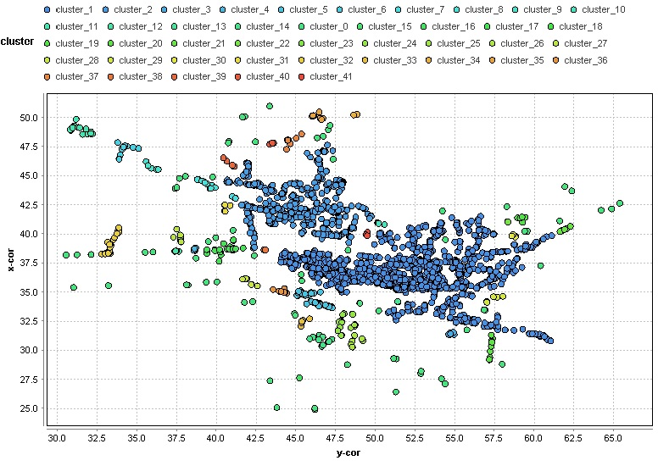

Slide 17
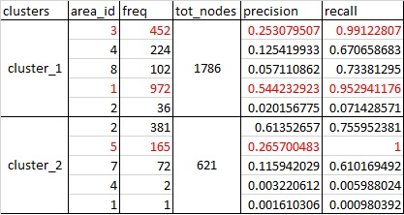
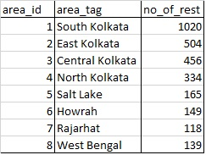
Snapshot of data: Precision and Recall values of cluster against the ground truth
Area tags with no. of restaurants in it (ground truth)

Slide 18
According to results:-
cluster_1
largest cluster formed
maximum nodes of South Kolkata, followed by Central Kolkata
95% of South Kolkata restaurants are part of this cluster
recall value of Central Kolkata is 0.991 - almost all the restaurants are present
Merge of South Kolkata and Central Kolkata
cluster_2
maximum nodes of East Kolkata
precision value is 0.614, recall value is 0.756
Salt Lake area not contributing much but entire Salt Lake area is present in this cluster (recall = 1)

Slide 19
Natural Language Processing for Review Analysis
Frequency of each term that appeared in the reviews of the restaurant with the most number of reviews - Chili’s Grill Bar Ballygunge was found
Aimed at understanding the usage of different words in reviews.
Words that are frequent in positive reviews and in negative reviews were found.

Slide 20
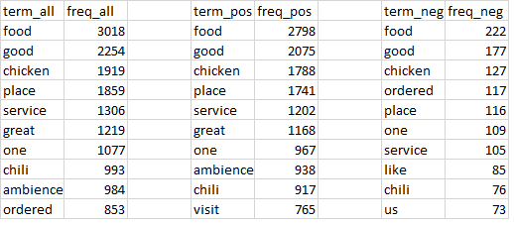
Snapshot of data:(from left) All terms with frequency, All terms in positive reviews with frequency and All terms in negative reviews with frequency

Slide 21
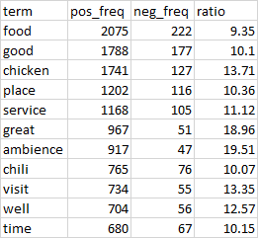
For the words that are present in both positive and negative reviews, the ratio of the frequency of its occurrence in positive reviews to that in negative reviews was found to get an idea of the context in which these common words have been used.

Slide 22
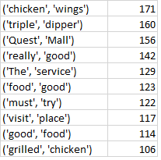
Extraction of bigrams - a list of word pairs that occur unusually often in the text was done, along with the frequency associated with each of them.

Slide 23
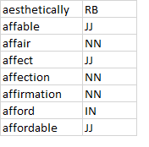
RB - adverb
JJ - adjective
NN - noun
IN - preposition / subordinating conjunction
Part-of-speech tagging - the process of classifying words into their parts of speech and labeling them accordingly was done. Parts of speech are also known as word classes or lexical categories.

Slide 24
Context detection using Latent Dirichlet allocation (LDA)
LDA is a topic model that generates topics based on word frequency from a set of documents. It is useful for finding reasonably accurate mixtures of topics within a given document set, in our case – the set of reviews of a user.
LDA assumes documents are produced from a mixture of topics. Those topics then generate words based on their probability distribution. We applied this model to the reviews of a couple of users to find the contexts of the reviews that the user had provided.

Slide 25
User 1
Sample review text -
“I love their ambience. I opted for their outdoor seating. Staffs are very well behaved. Decor was decent. I went there only to try their sizzlers. The entry to the restaurant was little weird, need to work on that. I ordered for sweet and salt fresh lime and chicken oriental sizzler. The combination went well. The sizzler was very well made, quantity was good too and the best part is it is very pocket friendly option in the area.”
[(0, '0.029*"good" + 0.015*"staff" + 0.013*"decor" + 0.013*"pocket"')] The words good, staff, décor, pocket were extracted as the topics from the user reviews. This implies that the user mostly talks about the staff, décor of the place and about the pocket friendliness of a restaurant.

Slide 26
User 2 -
Sample review text -
“What to say the food is bang on in taste and quality. I got an opportunity to try the food from this restaurant on my Kolkata visit. When I compared chinese cuisine to what they serve in hyderabad from what they serve here it's beyond any comparison. Kolkata chinese food stands apart. Coming to the food we ordered: Jumbo Golden Fried prawn: It was yummy. Prawns were properly cooked. No words to describe at all. Chicken lollipop: It compliment the prawns and Jack Daniels very well. Masala Chicken Pan Fry: This dish disappointed me a bit. Didn't turn out the way I was expecting it to from the name of the dish. Mixed Hakka Noodles: Really divine in taste. Kam-Pao Chicken: Had tasted Kam-Pao Chicken at so many restaurant but in comparison to taste this was best I had in recent times..”
[(0, '0.029*"good" + 0.015*"food" + 0.013*"chicken" + 0.013*"place"')] This user mostly talks about chicken, place, food and its highly probable that he finds it good.

Slide 27
Takeaway from LDA analysis
On verification of these results with the simple frequency analysis of the reviews user-wise, it was found that although most of the times the results of LDA and the latter are synonymous, in others they differ either in inclusion or in the probabilities that are assigned to them. Hence, LDA can be used in cases where there is a tie between a couple of words and we need to know how much weightage each of them carry.

Slide 28
Blue Star User
Also known as Zomato verified users
Maximum weightage attached to their rating
For classification, attributes used are:-
Number of reviews written by the user
The user’s foodie level
Number of followers of the user
Number of neighbourhood the user is an expert in

Slide 29
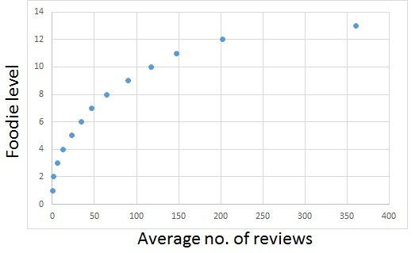
Foodie level depends on point a user has
Points depend on no. of reviews written
Pearson’s correlation coefficient R is 0.8701
Plot of Foodie level and average number of reviews per level
Foodie level is excluded as the classification factor

Slide 30
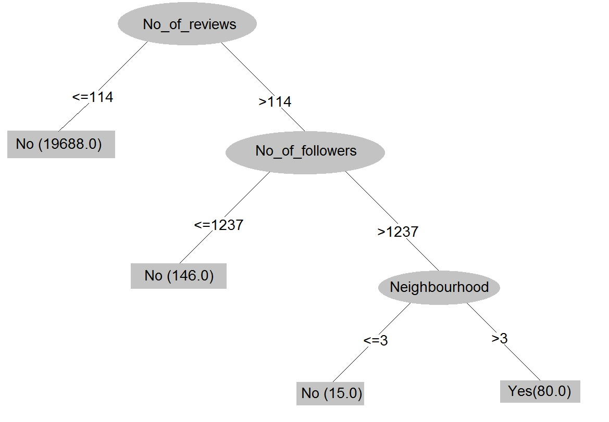
Decision tree: used for classifying verified and unverified users.
99.86% of the classification is done correctly (Runtime result of Weka)
Decision Tree for classifying Blue Star Users

Slide 31
Thank you

